Slide 1
Edge Computing and NextJS
anees.ahmed@gfk.com

Slide 2
BackGround: Computing Models:Definitions
(Read from Bottom to Top)
Cloud: Computing and data storage resources/services available over Internet, publicly available
Infrastructure: Where your app rus, Storage, Memory, Processing, Security & Complience, Networking,
Distributed: Multiple Processing and computing resources available as a single unit.
Networking vs Networks: Networking Means connecting computers, Networks means set of computers , connected with each other
Servers vs Computer: All Servers are computer, but a server is a computer that provide services to other computers.
Computing: Perform simple or Complex calculation on a given data
Processing: Computation plus storage of data and code
Devices: any electronic device that can connected with edge computing.

Slide 3
BackGround:Sever vs Serverless

Slide 4
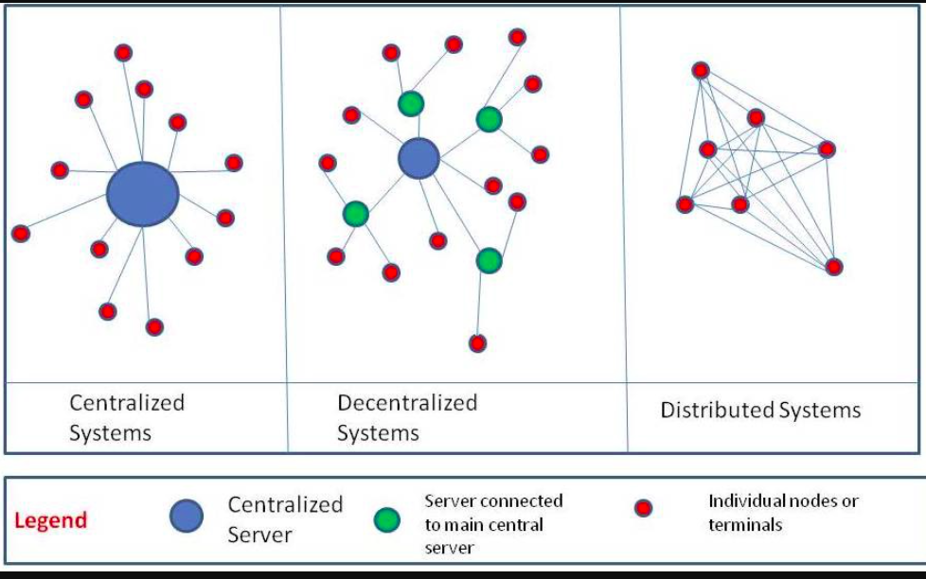
BackGround: Different Type of Computing Models
Question: How will your Typescript UIX will work here

Slide 5
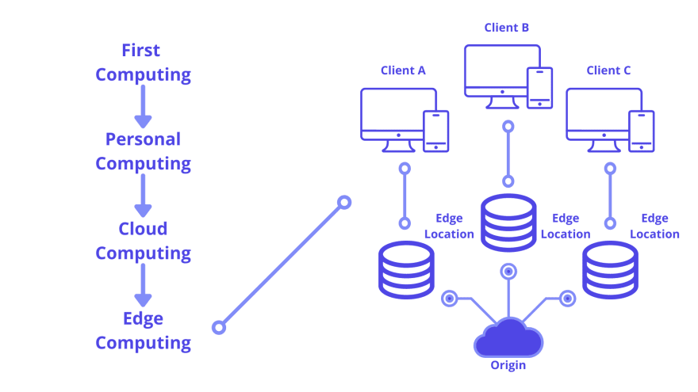
BackGround: Different Type of Computing Models
Question: How will your Typescript UIX will work here

Slide 6
Edge Computing Concepts (Networks)
Your Solution will not deploy on a server or single cloud instance. Instead It will deploy on Network (of servers, and resources)

Slide 7
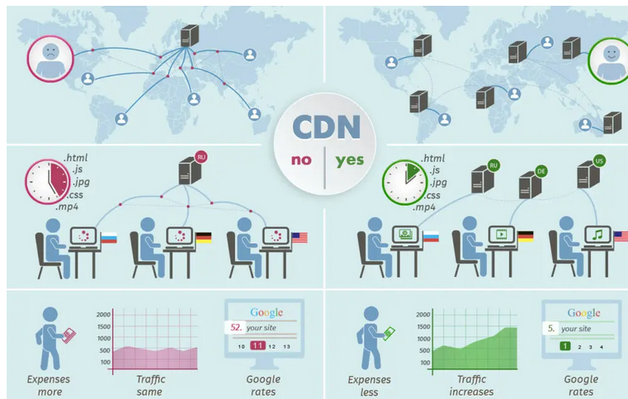
Edge Computing Concepts (Networks)
* Network Example:CDN

Slide 8
Connecting Dots: Edge Computing
(inNextJS Terms)
Clouds:( Infrastructure Core):
Origin-Servers: main computers that stores and runs the original version of your application code
CDN-Servers: store static content (such as HTML and image files) in multiple locations around the world and are placed between the client and the origin server.
Edge-Servers:generalized concept for the fringe (or edge) of the network, closest to the user.

Slide 9
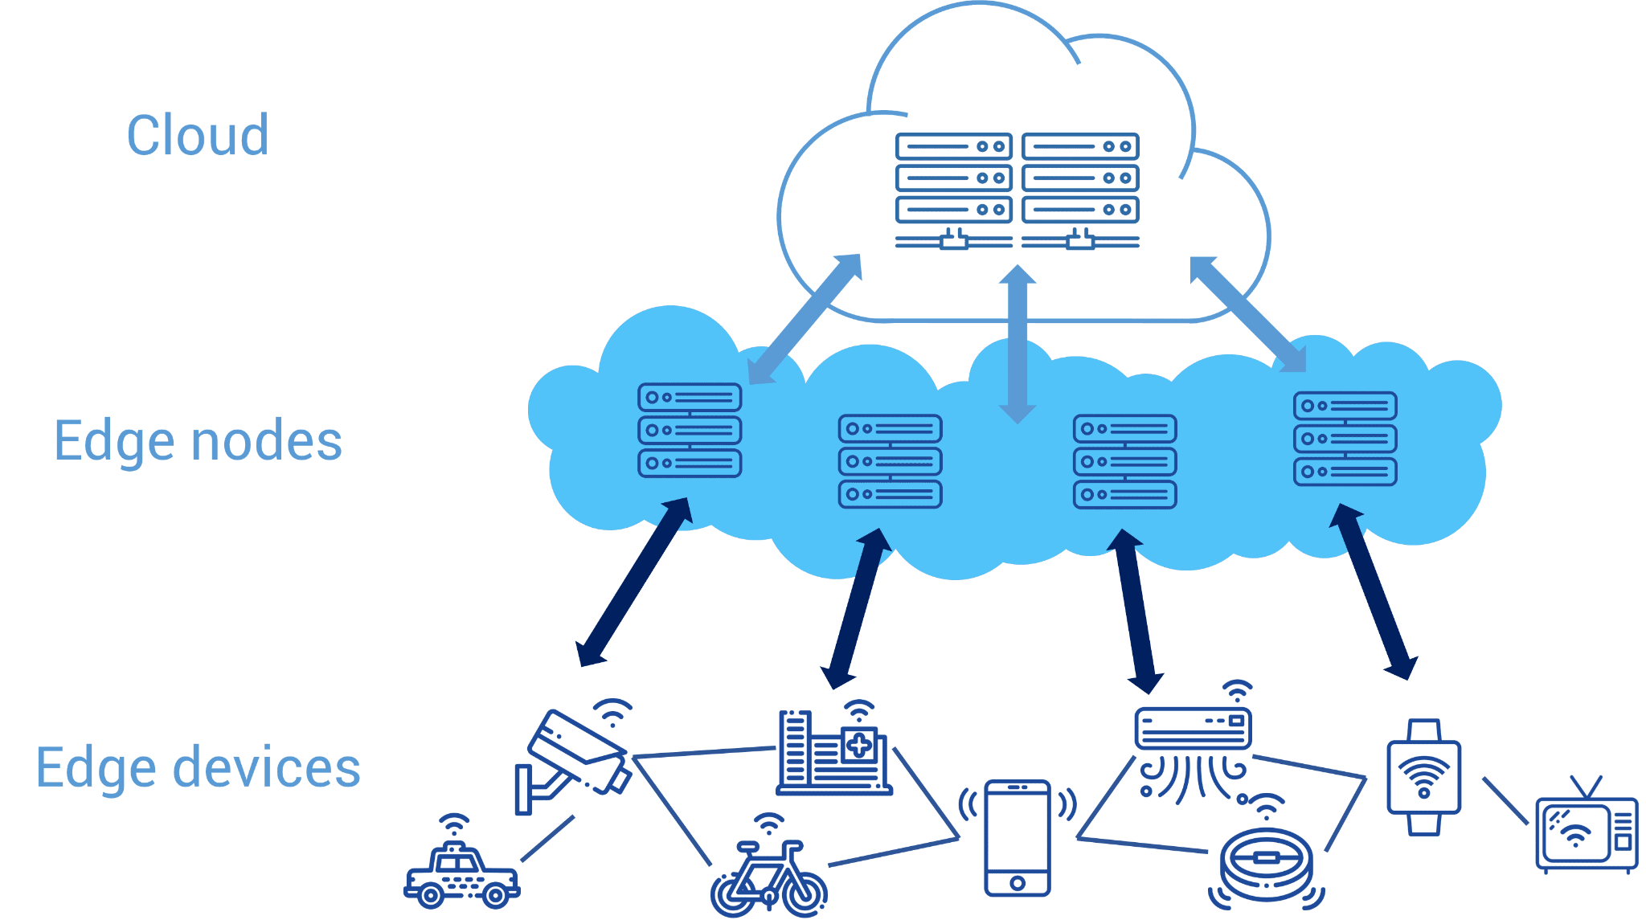
Edge Computing Concepts (the Edge)

Slide 10
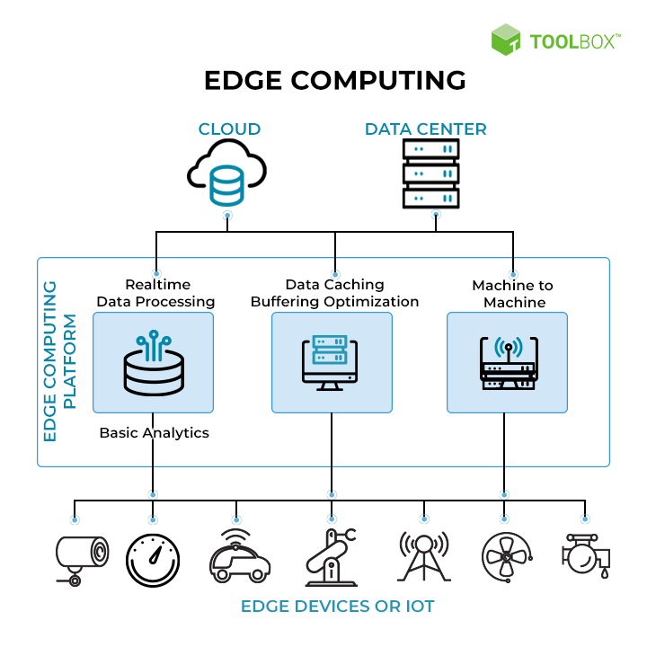
Connecting Dots: Edge Computing
(inNextJS Terms)

Slide 11
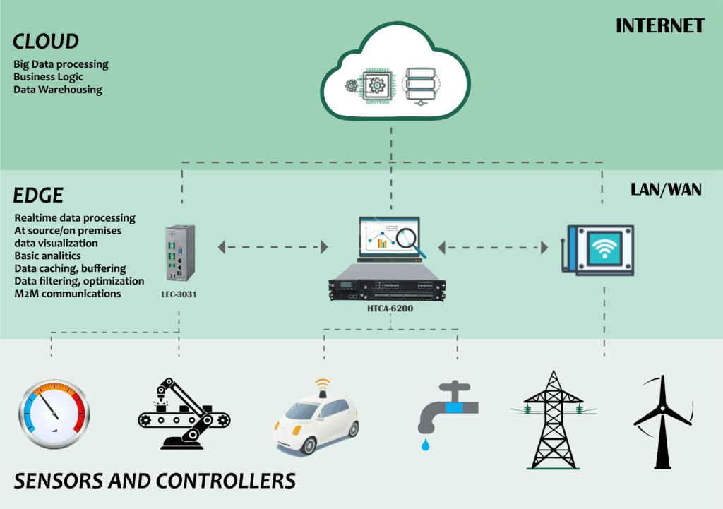
Examples of Edge Computing Solutions in Use Today
1-Grid Edge Control and Analytics
2-Oil and Gas Remote Monitoring
3-Edge Video Orchestration

Slide 12
Connecting Dots: Edge Computing
(inNextJS Terms)
Question: How will your Typescript, NodeJS, NextJS will work here

Slide 13
Connecting Dots: Edge vs CDN
(inNextJS Terms)
Question: What is Caching and how is different to CDN
CDNs could be considered part of "the Edge" because they store static content at the fringe (edge) of the network.
Similar to CDNs, Edge servers are distributed to multiple locations around the world
Edge servers can run small snippets of code.
Both Caching and code execution can be done at the Edge closer to the user.

Slide 14
How NextJs works in distributed Edge Computing
Clouds:( Infrastructure Core):
Origin-Servers: main computers that stores and runs the original version of your application code
CDN-Servers: store static content (such as HTML and image files) in multiple locations around the world and are placed between the client and the origin server.
Edge-Servers:generalized concept for the fringe (or edge) of the network, closest to the user.

Slide 15
NextJs services and Edge Computing
Cashing
Distributed code execution
Data fetching (again distributed)
Replicating data
Integration Apps

